Slide 1
Georgia State University Team MORSE Studio Smart Milk Spoilage Experiment
Students: Diana Avila, Kamrul Tarafder, Nahom Abera
Supervisor: Dr. Ashwin Ashok

Slide 2
Introduction
Background:
Milk is a perishable product that requires proper storage to prevent spoilage.
Understanding the impact of temperature on milk spoilage can guide storage practices and reduce waste.
Context:
This experiment simulates two common storage conditions, refrigerated and room temperature, to analyze spoilage progression.
Importance:
Insights from this study can inform consumer behavior, optimize storage conditions, and enhance food safety.

Slide 3
Objective
Purpose:
To evaluate how temperature influences the spoilage of milk over time.Key
Questions:
How does temperature vary in refrigerated and unrefrigerated conditions over time?
How does spoilage progression differ between the two storage setups?

Slide 4
Experimental Setup
Setups: One Milk stored in a refrigerator and another Milk stored at room temperature.
Hardware: MYOSA Motherboard, MYOSA BMP180 Barometric Pressure Sensor, Raspberry Pi and Camera
Software: Python, C++, Arduino IDE
Additional Evaluation: Smell both milk samples twice daily and record observations and their storage temperature.
Timeframe: 2 weeks.
Storage Conditions:
Refrigerated Milk: Maintained at 37 – 40°F.
Unrefrigerated Milk: Exposed to room temperature 67 - 70°F.

Slide 5
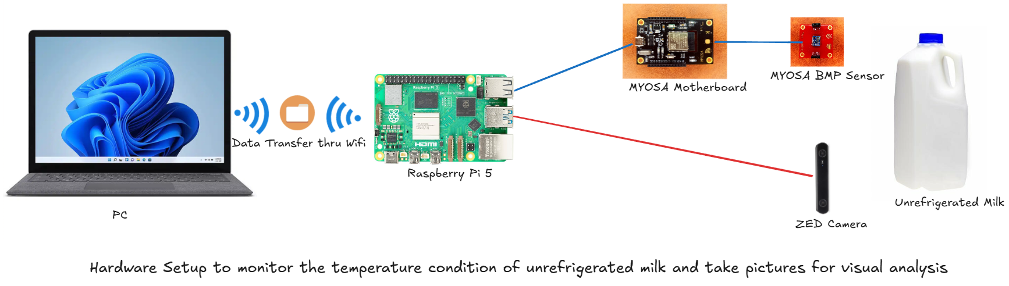
Hardware Setup

Slide 6
Methodology
Temperature Measurement Setup:
The unrefrigerated milk's temperature was monitored using a MYOSA BMP sensor connected to a MYOSA board, which was interfaced with a Raspberry Pi.
The BMP sensor measured temperature in both Fahrenheit (°F) and Celsius (°C).
Temperature data was recorded every five minutes by the Raspberry Pi and stored in an organized log file for later analysis.
Image Capture Setup:
The Raspberry Pi was equipped with a camera module to capture images of the unrefrigerated milk at regular interval.
Pictures were taken every five minutes during the monitoring process.
For the refrigerated setup, images of both the refrigerated and unrefrigerated milk were captured twice daily using a phone camera.
Smell Test and Manual Data Collection:
Twice daily, a smell test was conducted for both setups:
Refrigerated Milk: The smell was assessed and classified into categories (e.g., "Fresh," "Slightly Sour," "Noticeably Sour," "Sour/Spoiled").
Unrefrigerated Milk: Similarly, the smell was categorized based on the same criteria.
Simultaneously, temperature readings from:
The refrigerator's cooler for the refrigerated milk.
The BMP sensor for the unrefrigerated milk.
These measurements, along with the smell classification, were manually recorded in an Excel sheet.

Slide 7
Analysis
Time Range: November 30, 2024, through December 12, 2024
Refrigerated Milk
Progression:
Nov 30 – Dec 4: Milk remained Fresh.
Dec 5 – Dec 7: Transitioned to Slightly Sour.
Dec 8 (Expiration Date): Milk was still Slightly Sour, matching the printed use-by date.
Dec 10: Became Noticeably Sour.
The refrigerator, stable at ~37 – 39°F, significantly delayed spoilage. The milk took about 5 days to leave the Fresh stage and only became Noticeably Sour around Day 10.
Unrefrigerated Milk
Progression:
Nov 30 – Dec 1: Milk went from Fresh to Slightly Sour by Day 1–2.
Dec 2: Recorded as Noticeably Sour.
Dec 3: Fully Sour/Spoiled (about 3–4 days after exposure).
Room Temperature stayed around 67–69°F; these stable but warm conditions accelerated bacterial growth.
Impact on Spoilage
Unrefrigerated Milk:
Began spoiling within 24–48 hours, quickly progressing to Sour/Spoiled by Day 3–4.
Refrigerated Milk:
Showed no spoilage until around Day 5, turning Slightly Sour shortly before the labeled Dec 8 expiration date.
Shifted to Noticeably Sour near Day 10, indicating the milk remained acceptable but gradually worsening past its official expiration date.

Slide 8
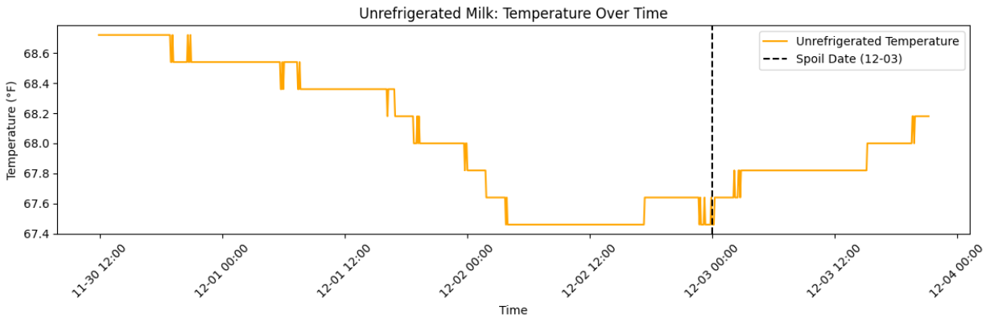
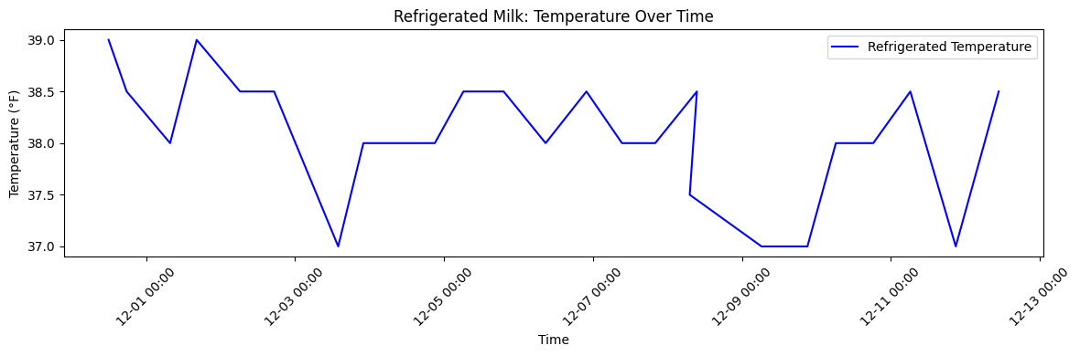
Graphs and Visualizations - 1
Unrefrigerated Milk Temperature Over Time
Refrigerated Milk Temperature Over Time

Slide 9
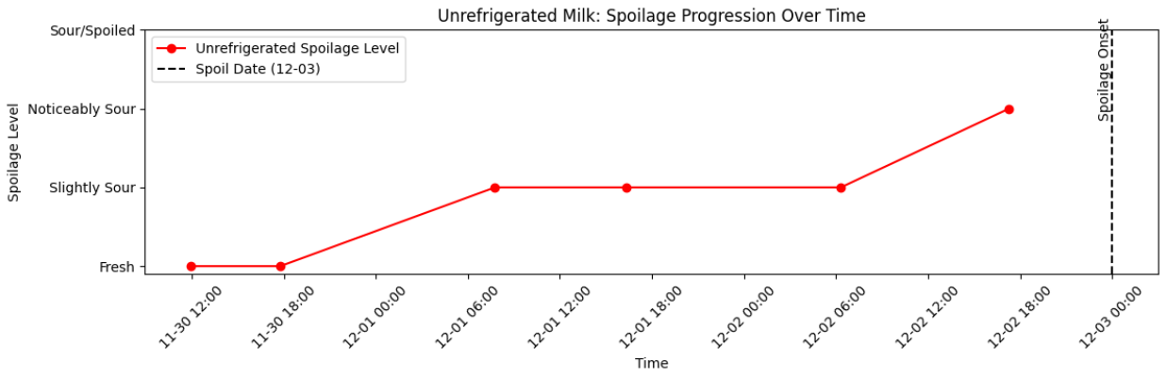
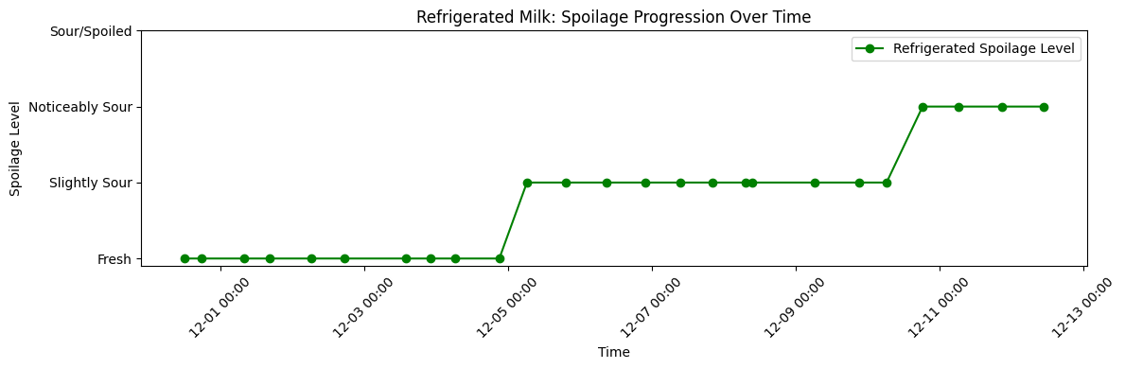
Graphs and Visualizations - 2
Unrefrigerated Milk Spoilage Progression Over Time (Smell Score)
Refrigerated Milk Spoilage Progression Over Time (Smell Score)

Slide 10
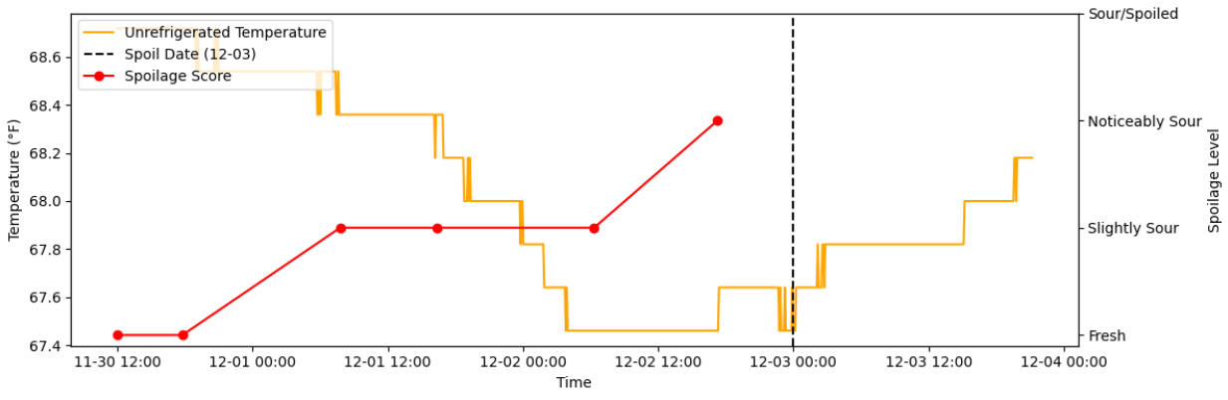
Graphs and Visualizations - 3
Unrefrigerated Milk Temperature and Spoilage Over Time

Slide 11
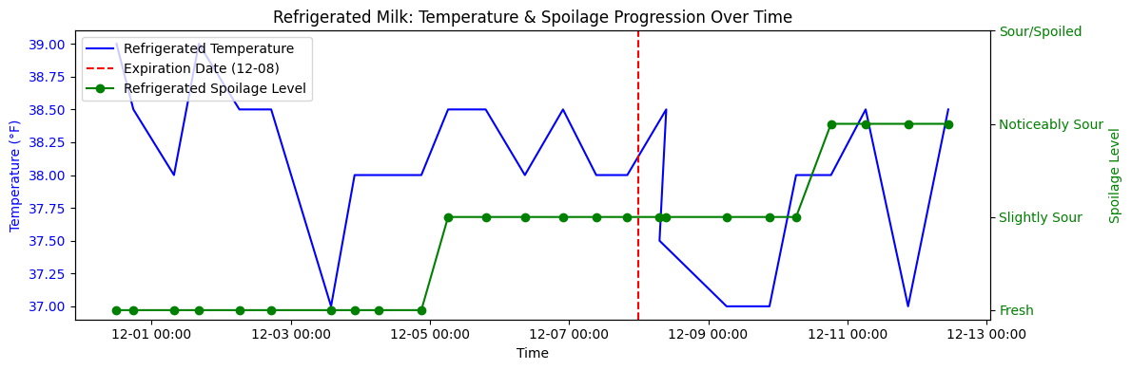
Graphs and Visualizations - 4
Refrigerated Milk Temperature and Spoilage Over Time

Slide 12
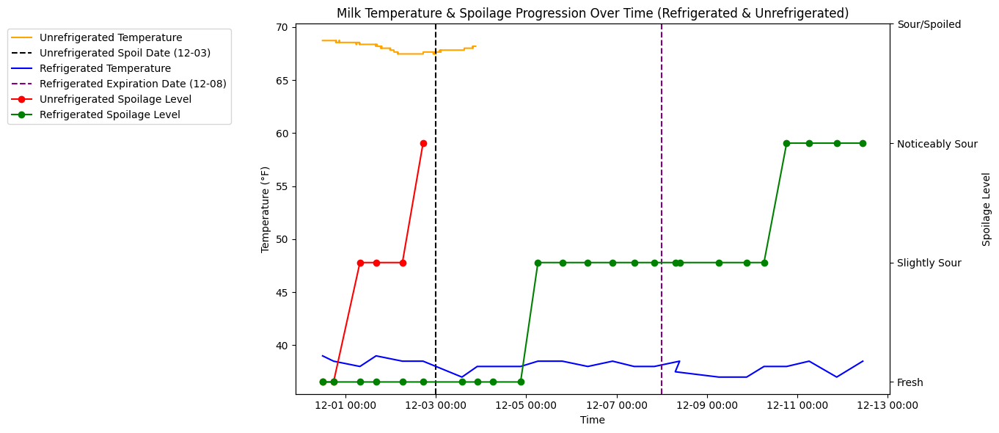
Graphs and Visualizations - 5
Milk Temperature & Spoilage Progression Over Time (Refrigerated & Unrefrigerated)

Slide 13
Results
Unrefrigerated Milk:
The data shows that milk stored at room temperature (~68°F) began to exhibit signs of spoilage within about one to two days, transitioning from “Fresh” to “Slightly Sour” and eventually “Noticeably Sour.”
By December 3rd, the unrefrigerated milk had reached a clearly “Sour/Spoiled” state, as confirmed by smell tests and visual evidence (including curdling and discoloration).
The relatively high ambient temperature accelerated bacterial growth, resulting in a rapid spoiling process within 3–4 days total.
Refrigerated Milk:
The refrigerated milk’s temperature remained consistently around 38°F, significantly slowing bacterial activity.
Over the same time frame, the refrigerated sample stayed “Fresh” for roughly 5 days, showing only a slight sourness near Day 5–6.
By Day 9–10—shortly after the container’s labeled expiration date (December 8)—the milk progressed to “Noticeably Sour.”
This marked difference in spoilage rate underscores how proper refrigeration can extend milk’s usable life well beyond what is seen at room temperature.
Key Observations
Higher storage temperature correlates with faster spoilage.
Proper refrigeration delays both smell- and sight-based signs of degradation.
The December 3rd spoilage date for unrefrigerated milk underscores how quickly milk can degrade without temperature control.
The refrigerated sample’s gradual transition around Day 5–6 highlights the protective effect of maintaining ~38°F storage.

Slide 14
Conclusion
Based on the results of this experiment, we can strongly affirm the pivotal role of temperature in milk spoilage. The unrefrigerated milk, held at about 68°F, deteriorated rapidly—transitioning from “Fresh” to “Slightly Sour” within the first 1–2 days and becoming fully “Sour/Spoiled” by Day 3–4. In stark contrast, the refrigerated milk, maintained at a stable 38°F, remained “Fresh” for roughly 5 days and only developed a slight sourness around Day 5–6. It did not reach a clearly “Noticeably Sour” state until Days 9–10, even surpassing its labeled expiration date of December 8.
These findings reinforce standard food safety guidelines that emphasize the importance of proper refrigeration to curb bacterial growth and extend dairy product shelf life. By combining smell-based scoring, temperature logs, and visual inspections, we captured the full scope of how storage (Temparature) conditions drive the onset and progression of spoilage.

Slide 15
Thanks!

